Slide 1

B.Tech Project External Evaluation, VIIIth Sem
Image Caption Generator using CNN and LSTM
Presented by :-
Supriya Kumari,(2018009684)
Julu Basnet,(2018015987)
Mohit Rathore,(2018015523)
Dipanshu,(2018014442)
Under the Supervision of:-
( Dr.Vivek Kumar Singh)
Sharda University, Gr. Noida
DEPARTMENT OF COMPUTER SCIENCE & ENGINEERING
SCHOOL OF ENGINEERING AND TECHNOLOGY
May, 2022
1

Slide 2
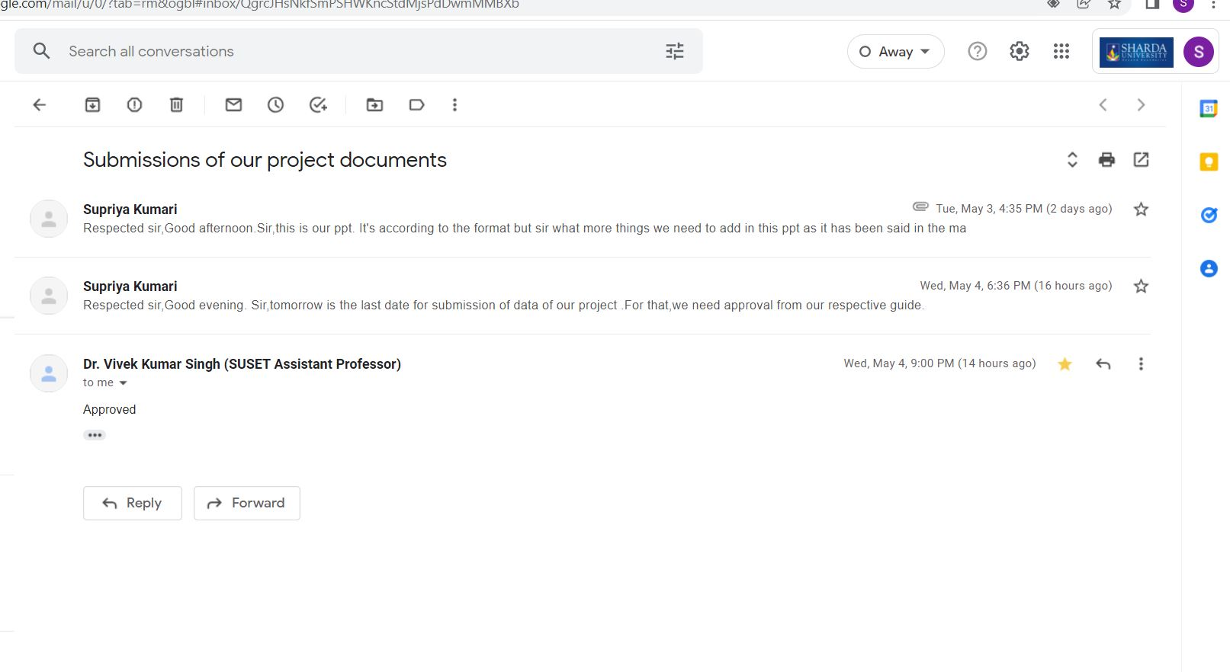
Approval from guide for the evaluation

Slide 3
Contents of the Presentation:
1.Project Overview............................................................................i
2.Introduction....................................................................................ii
3.Problem Statement........................................................................iii
4 .Dataset Preparation......................................................................iv
5.Proposed system............................................................................v
6.Batch Processing……………...……...............................................vi
7.Word Embedding……………...……...............................................vii
7.Working model...............................................................................vii
8. Model Architecture.......................................................................viii
9.Results and output…………………………………………………….ix

Slide 4
Project Overview This project,Image Caption Generator using deep learning method has been taken Describe the learning model used, the specification and implementation of the algorithms and, as a result, the web development application, we need to explore the latest approaches to the image captioning generator. To collect image information the usage of static object class libraries in the image and model use of statistical language models. There are two approaches in the field of applications. Firstly, to detect objects in the image using CNN and other is to caption the image using RNN based totally on LSTM. The interface of the model is developed using Flask Rest-API, a web framework of python. We have used VGG16,InceptionV3 (pre-trained)model to the CNN model . The methodology of this project consists of CNN layers.These are convolutional layer,pooling layers and fully-connected layers. We trained the model on the training dataset using tensorflow library,after this the output gets predicted.

Slide 5
Workload distribution of the team
Team Members | Data Collection | Data loading and preprocessing | Model building | Training the dataset | Predict Caption | Test the model
Supriya Kumari |  |  |  |  |  | 
Julu Basnet |  |  |  |  | 
Mohit Rathore |  |  |  |  |  | 
Dipanshu |  |  |  |  | 

Slide 6
Introduction to the Project
Image Captioning is the generation of captions for a given image. These
captions are generated using Natural Language Processing(NLP)
and Computer Vision together.
Technology is a new ray of hope in the lives of hopeless visually impaired people, they are facing many difficulties in their daily life, and without the sharpness of sight life is a very challenging task. AI is one of the sciences which can solve this problem known as Image Caption Generation(ICG), image captioning is a key for visually impaired people. It's capable to describe the content of a picture using precisely formed English sentences. but it could also have a major effect by helping visually challenged humans improve their understanding of the content of the picture. It performs the task of detecting objects using pre-trained models, and it generates captions using a Convolutional Neural Network and Long Short Term Memory.

Slide 7
Problem Statement
If we use static class libraries in the inputs for picture captioning,the problem begins with the detection of the object..The images’s aspects are assigned distinct biases and weights,which aids in the distinguishing of individual objects or the overall image.The CNN-LSTM architecture,which incorporates both computer vision and machine translation was used in the study.The vanishing gradient problem is addressed by LSTM.This problem will be addressed by utilizing CNN as a encoder and LSTM as a decoder.By the help of encoder-decoder,we’ll overcome this problem.We’ll build an architecture by merging both the CNN and LSTM which then trains the neural network.Though it is a challenging task,it’s benefit ranges from aiding the person having sight problem to enabling different labels of the images to the internet with cost saving.

Slide 8
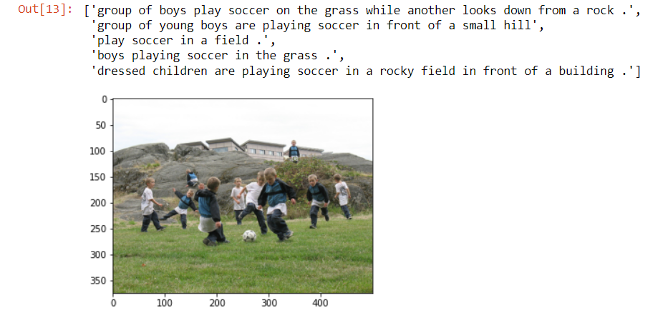
Each image has mapped to five different sentences which describes the image.

Slide 9
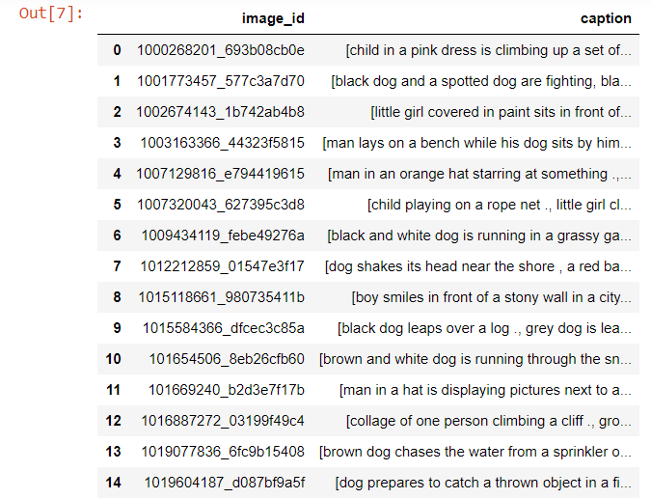
Dataset Preparation
Flickr-8k dataset contains 8092 images and five captions for each image. so there are total 40,455 captions in the dataset.
The dataset is about 8GB in size.
Extract features from images using VGG16, Inception v3
Getting a descriptions for each image
Clean the descriptions by removing punctuations,turning all words into lowercase letters and removing numbers.

Slide 10
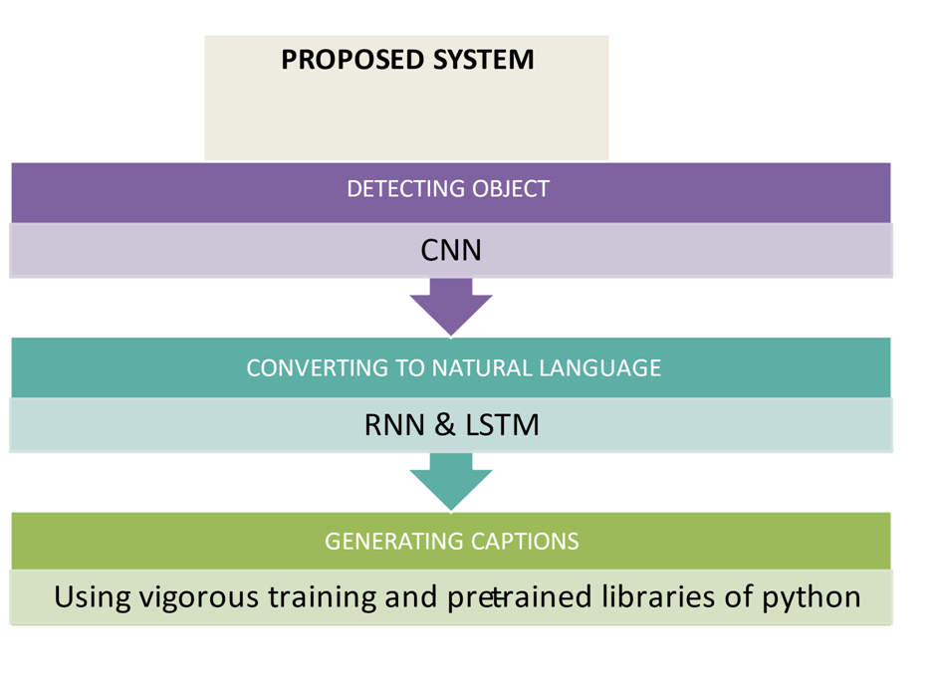
Proposed System

Slide 11
Batch processing
when training the model, we don’t want to have to wait until the model has seen all of the data before a weight update is performed. That’s computationally inefficient. Instead, we take, for example, 100 random examples of each class and call it a ‘batch’. we train the model on that batch,perform a weight update,and move to the next batch,until we have seen all of the examples in the training set. One pass through the training set in this manner is called an ‘epoch’.

Slide 12
Word Embedding
Word embedding is a real number, vector representation of a word. when constructing a word embedding space,typically the goal is to capture some sort of relationship in that
space,be it meaning,morphology, context, or some other kind of relationship.
Glove (global vector for word representation) is an unsupervised learning algorithm developed by stanford for generating word embeddings by aggregating global word-word-co-occurrence matrix from a corpus.

Slide 13
Working model
1.Import the requirement libraries
2.Loading data
3.Generate and perform data cleaning
i)Load descriptions for each image.
ii)Clean the description by removing punctuations, converting all words to lowercase
and removing words that contain numbers.
iii)create a vocabulary from all the descriptions
iv) save the descriptions.
v) loading the train data
4. Data Preprocessing -images
5.Extract the feature from all images using InceptionV3 model
(Removing a last layer (output layer of 1000 classes ))
6.Training the model
7.Tokenizer the vocabulary
8.Model Architecture(cnn-lstm model)
9.Model Evaluation- Belu(Bilingual Evaluation Understudy Score)
10.Testing the model

Slide 14
1.Import the requirement libraries
-Tensorflow
- keras
- pickle
- nltk
2. Load the data
3. Getting a description for each image
4.Cleaning the text:
- NLP is to remove noise
- Noise will be present in the form of special characters such as hashtags,
and numbers. so we need to remove these for better results.
5. Generate the vocabulary
- Vocabulary is a set of unique words which are present in our text corpus.
- vocabulary size-357158

Slide 15
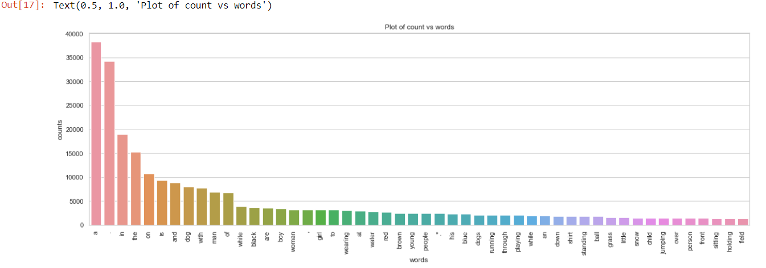
6. Count the repeated word
- Count the number of times a word appears in the description file.

Slide 16
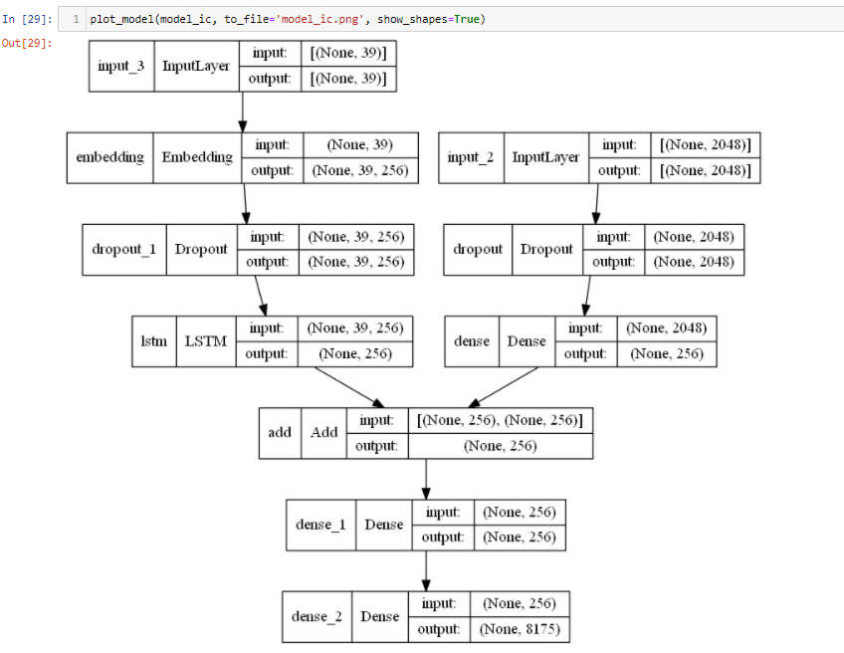
Model Architecture
Photo Feature Extractor
- Input photo features as
vector of 2048 elements.
Sequence Processor
- Input sequence of 39 words
- Embedding layer that used to
ignore padding
- LSTM with 256 memory units
Decoder
- Add both outputs from the two
units
- Dense layer to make prediction
of next word.

Slide 17
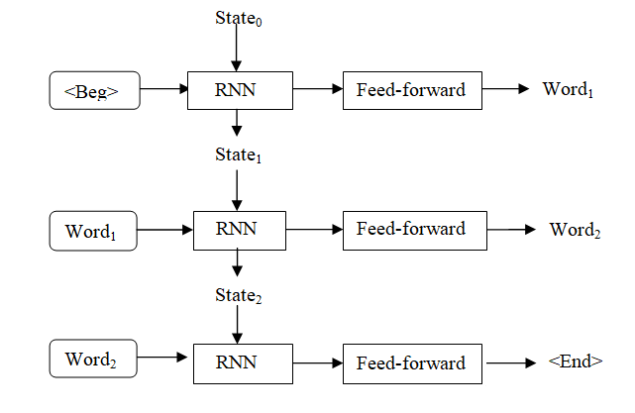
Working of RNN
RNN encodes a prefix,which
incorporates the output word
derived from the previous state.
The network does not output a
single word but a probability distribution over all known words
in the vocabulary.

Slide 18
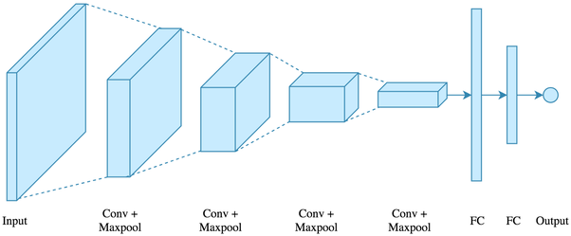
CNN-LSTM Architecture
A.Convolutional Neural Network:
It is deep learning algorithm in which the inputs are images.
It is made up of a number of neural networks which consists of connection of three different layers,convolutional,pooling and fully connected layers.

Slide 19
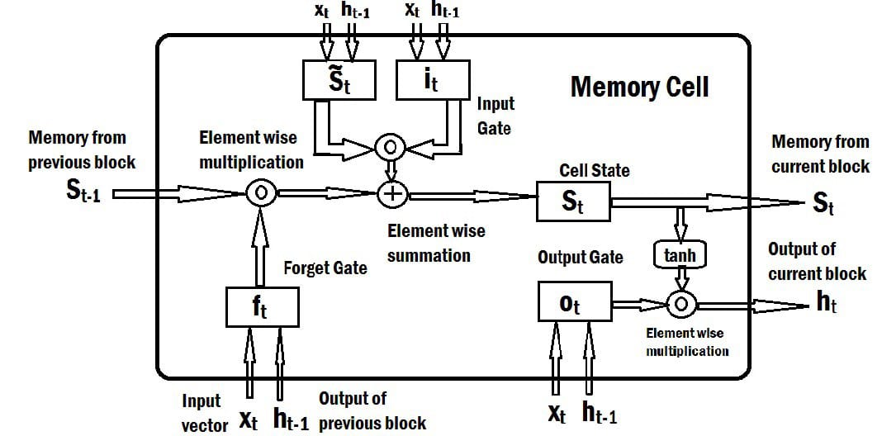
Cont...
B.LSTM
LSTM pulls data from CNN and uses that to build a textual description of the image that was provided .
LSTM consists of input gate,output gate and forgate gate.
It helps to keep memories long-lasting and solves the problem of sequence prediction.

Slide 20
Deploying as a Web Application
we have used Flask to deploy our project as a Rest-API in the form of a web
application.
Flask is a web application framework of Python used mostly to deploy machine learning models.

Slide 21
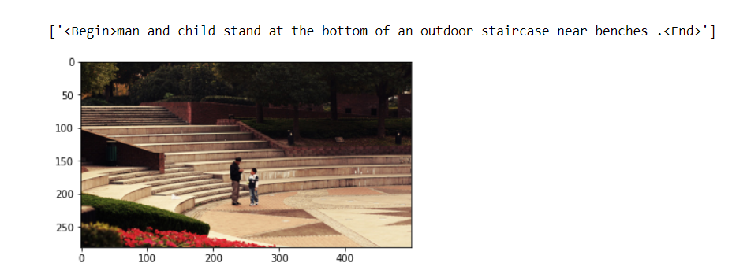
Results and output

Slide 22
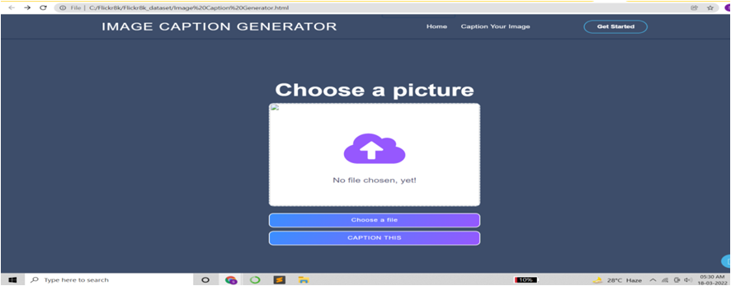
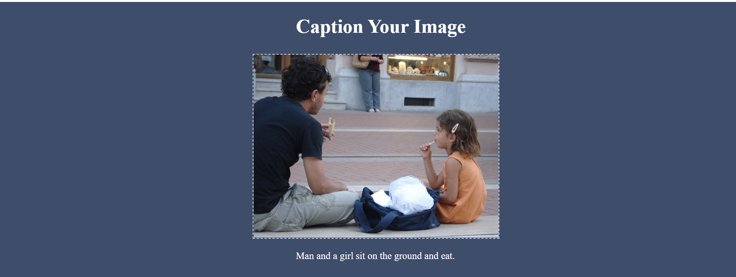
Result

Slide 23
Thank You

